Slide 1
Integrating Crowdsourcing and GIS to Slow the Spread of the Emerald Ash Borer in Minnesota
By Caleb Mackey

Slide 2
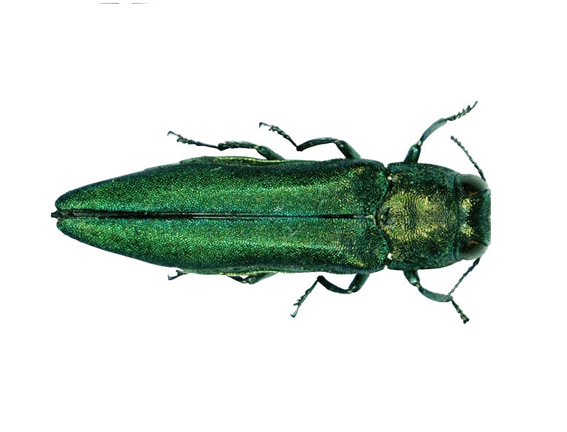
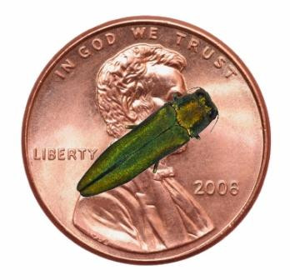
Emerald Ash Borer (EAB)
Invasive beetle from Asia
1-2 Year life cycle
Larvae eat through the inner tissue of ash trees
Killed hundreds of millions of Ash trees in North America
10mm
2 mm
Notes:
Because they live in the wood for up to two years, people unknowingly transport infested wood

Slide 3
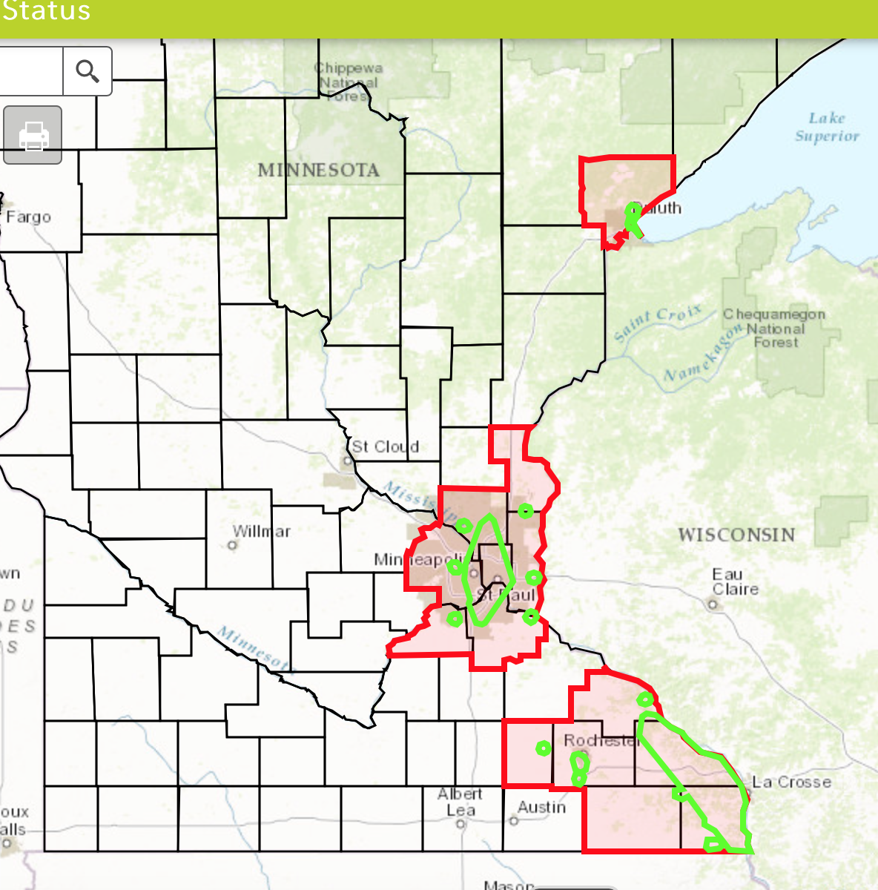
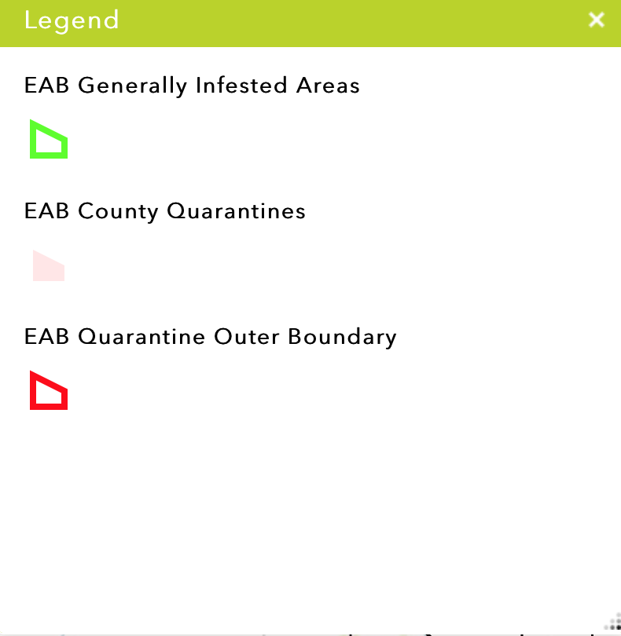
EAB Distribution in Minnesota
Notes:
- St Paul, MN - First reported sightings in 2009
~26,000 ash in public ROW, tens of thousands more in city parks
2015 – EAB city wide coverage went from 55-75%
Up from 3.5% in 2010!

Slide 4
Motivation and Objectives
The EAB is spreading rapidly in MN
Early Detection is extremely important to slowing their spread! What can I do to help?
Objectives
Evaluate current practices and challenges of EAB Detection in MN
Technology assessment and EAB Tracker App Design for reporting sightings.
Improve early detection and alert mechanisms related to tracking and mitigation of EAB infestations.

Slide 5
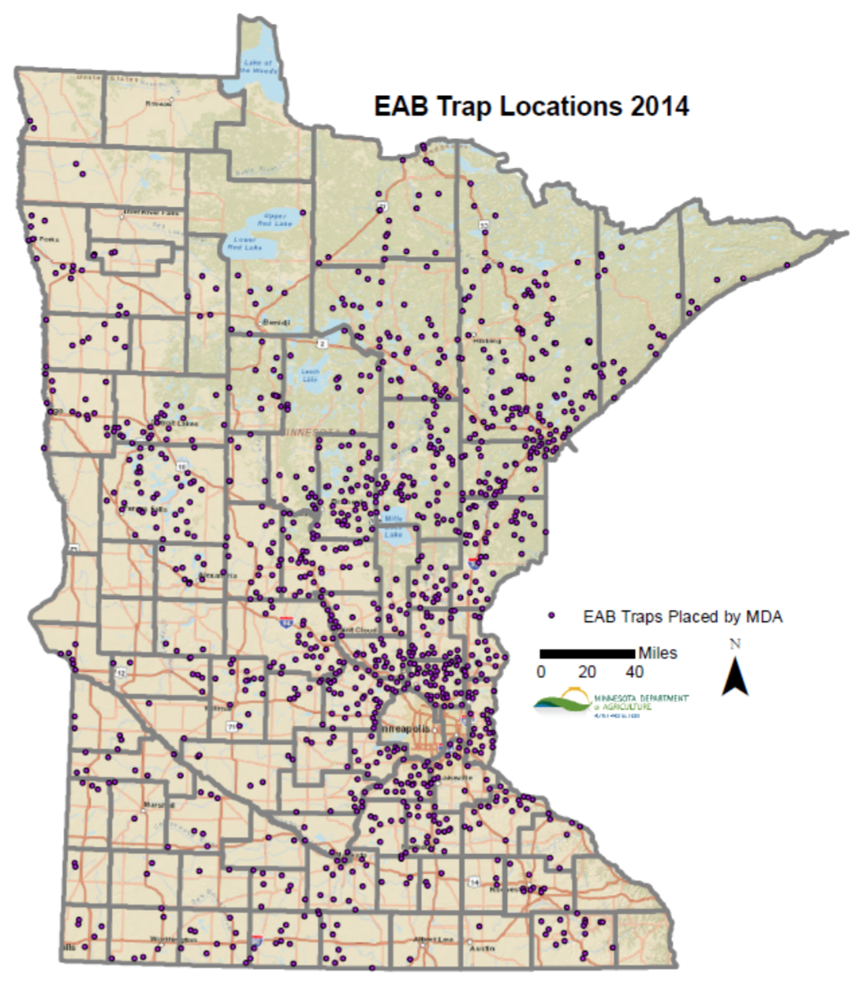
Detection of the EAB in Minnesota
The Minnesota Department of Agriculture (MDA) is the lead agency in Minnesota for monitoring the movements of the EAB.
Monitor Purple Prism Traps
Field inspections in high risk areas
Rely on visual cues of EAB Attacks
Engage the public
Notes:
Engaging the public – Workshops. MDA encourages people to report sightings via email

Slide 6
Reaction to Infestations
Quarantines issued in response to new sightings
No firewood can be moved outside of quarantine
Typically done at the county level
When a county is quarantined, the MDA will begin mitigation planning
Bio controls
Insecticides

Slide 7
Technology Assessment
My Solution: Develop a native mobile application
Target Platforms?
Android: ~71% market share
iOS: ~23% market share
Why Native Application over Web application?
Better performance
Full access to device capabilities
Push notifications, device sensors, local storage
Does not require having a web server (web app must be hosted from somewhere)

Slide 8
Application Design
Goals of EAB Tracker
Allow user to report sighting
Provide a simple identification guide for EAB and Ash trees
Map that shows MDA EAB GIS data
Automatically generate an email to send to the MDA’s “Arrest The Pest” email account
Send push notifications when new sightings are reported
Add authentication so the MDA can login to edit data

Slide 9
Application Design
Data and Software
Sightings were published as a hosted Feature Service in ArcGIS Online for data collection.
MDA EAB REST Endpoints used in app (from ArcGIS Online)
The ArcGIS Runtime Software Development Kits (SDKs) for iOS and Android
Exposes ArcGIS functionality it native apps

Slide 10
Application Development
iOS
Built with Swift programming language and the Xcode Integrated Development Environment (IDE)
Android
Built with the Java programming language and Android Studio IDE.
Both apps require special user permissions:
Camera / media access
GPS (location services)
Internet access

Slide 11
VGI – “Humans as Sensors”
Citizens using technology to record geographic data
The MDA is encouraging volunteers to help with early detection
Web GIS can be used to facilitate VGI
Notes:
How can we help with early detection? VGI!

Slide 12
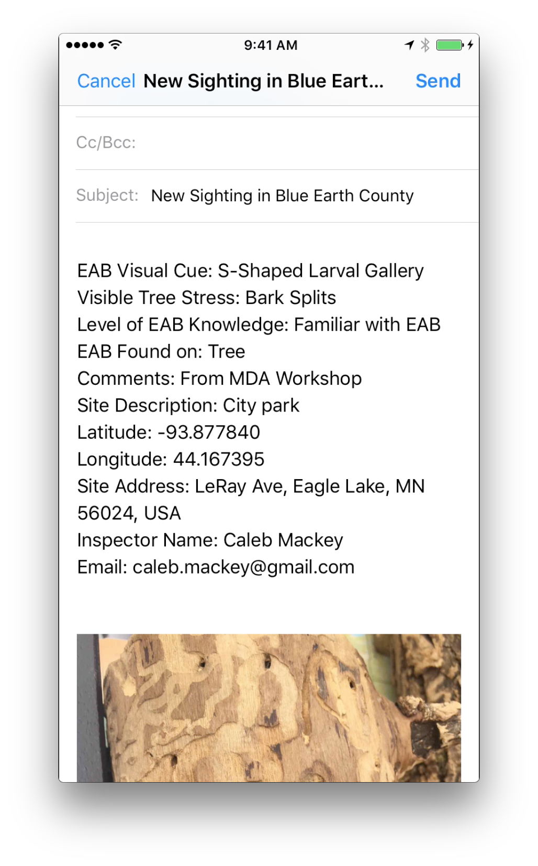
Alert system
Push notification
Email
Notes:
How can we help with early detection? VGI!

Slide 13
Demo

Slide 14
Results and Discussion
Identified the challenges associated with EAB reporting in the State of Minnesota
Successfully designed and developed EAB Tracker App for iOS and Android platforms.
The user friendly interface of these applications can help enhance public participation.
The mobile applications promote VGI and could help MDA find more infestations quickly without investing much time.
The apps can assist in early detection so the MDA can institute quarantines and start mitigation.

Slide 15
Conclusion
The MDA has too much ground to cover, they need volunteers to report sightings.
Created prototype apps that can successfully report EAB sightings.
Can help in early detection
MDA can act quickly to gain control over the local population before it spreads.

Slide 16
Future Work
The biggest challenge will be getting people to use the app.
How to get the word out?
How to educate people that this is an important issue and they can help?
Add offline capabilities
Add push notifications
Beta testing for usability and design of app

Slide 17
Questions?
Thank You!

Slide 18
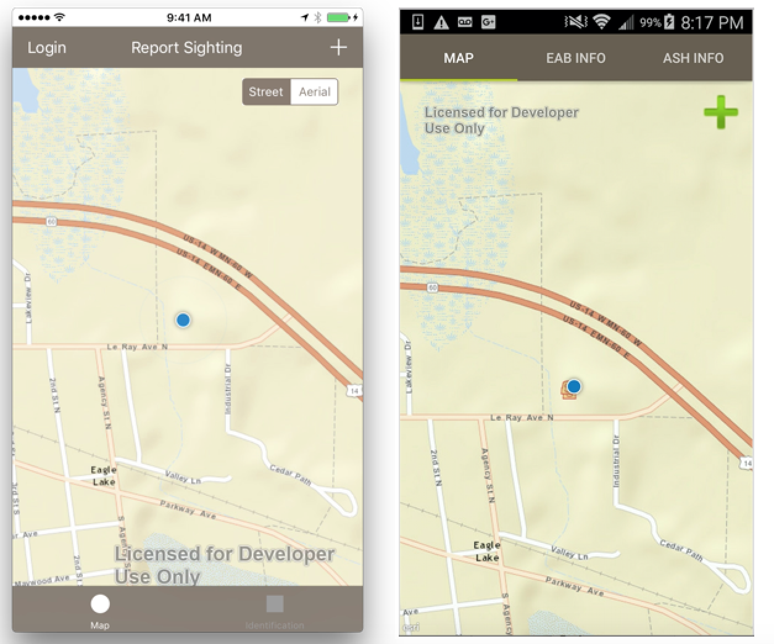

Slide 19
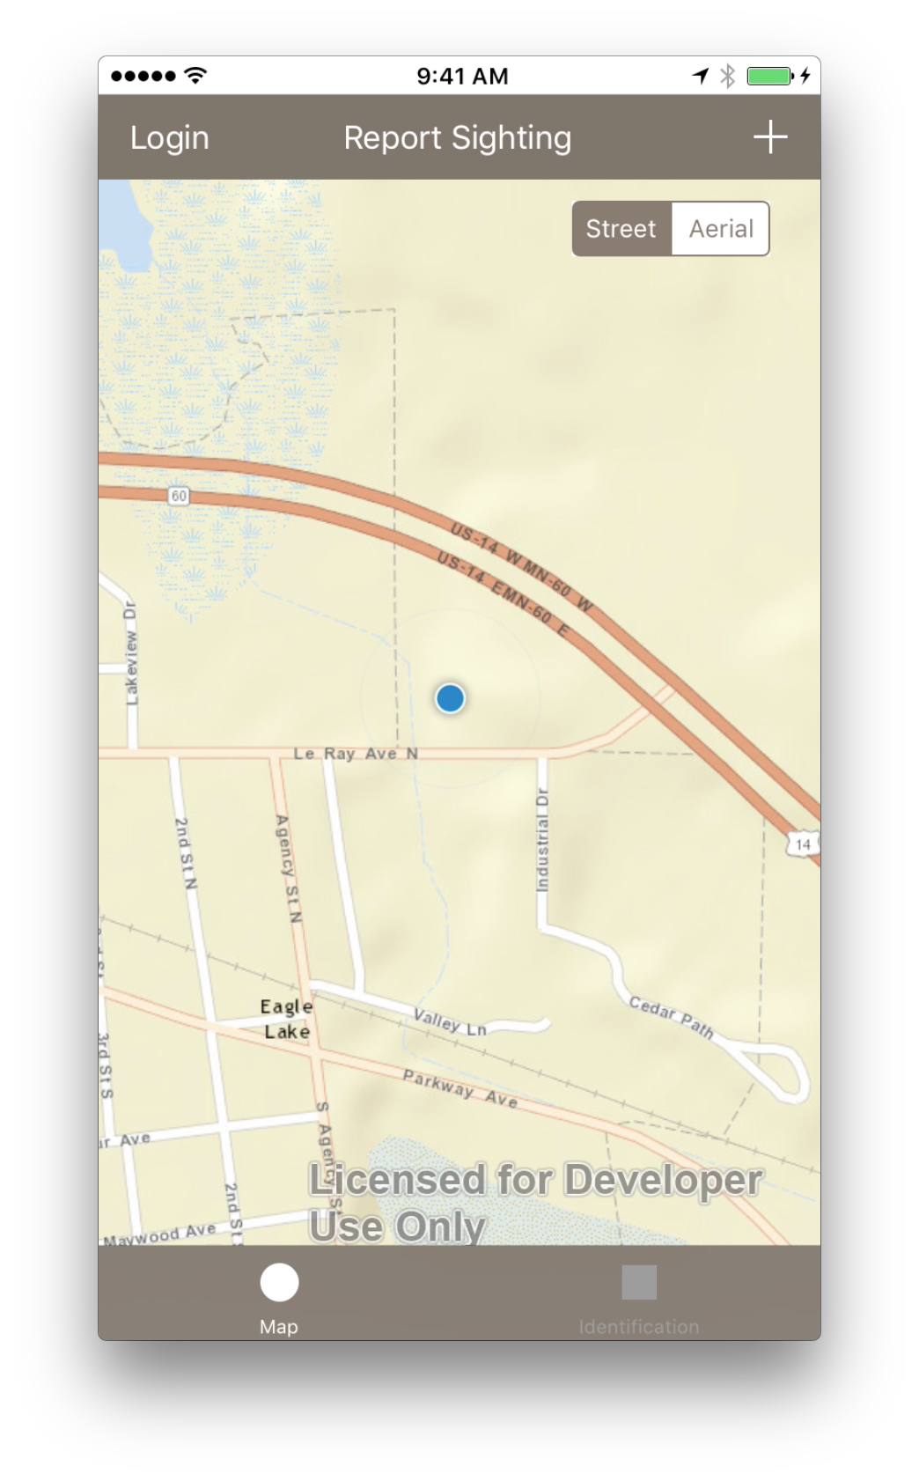
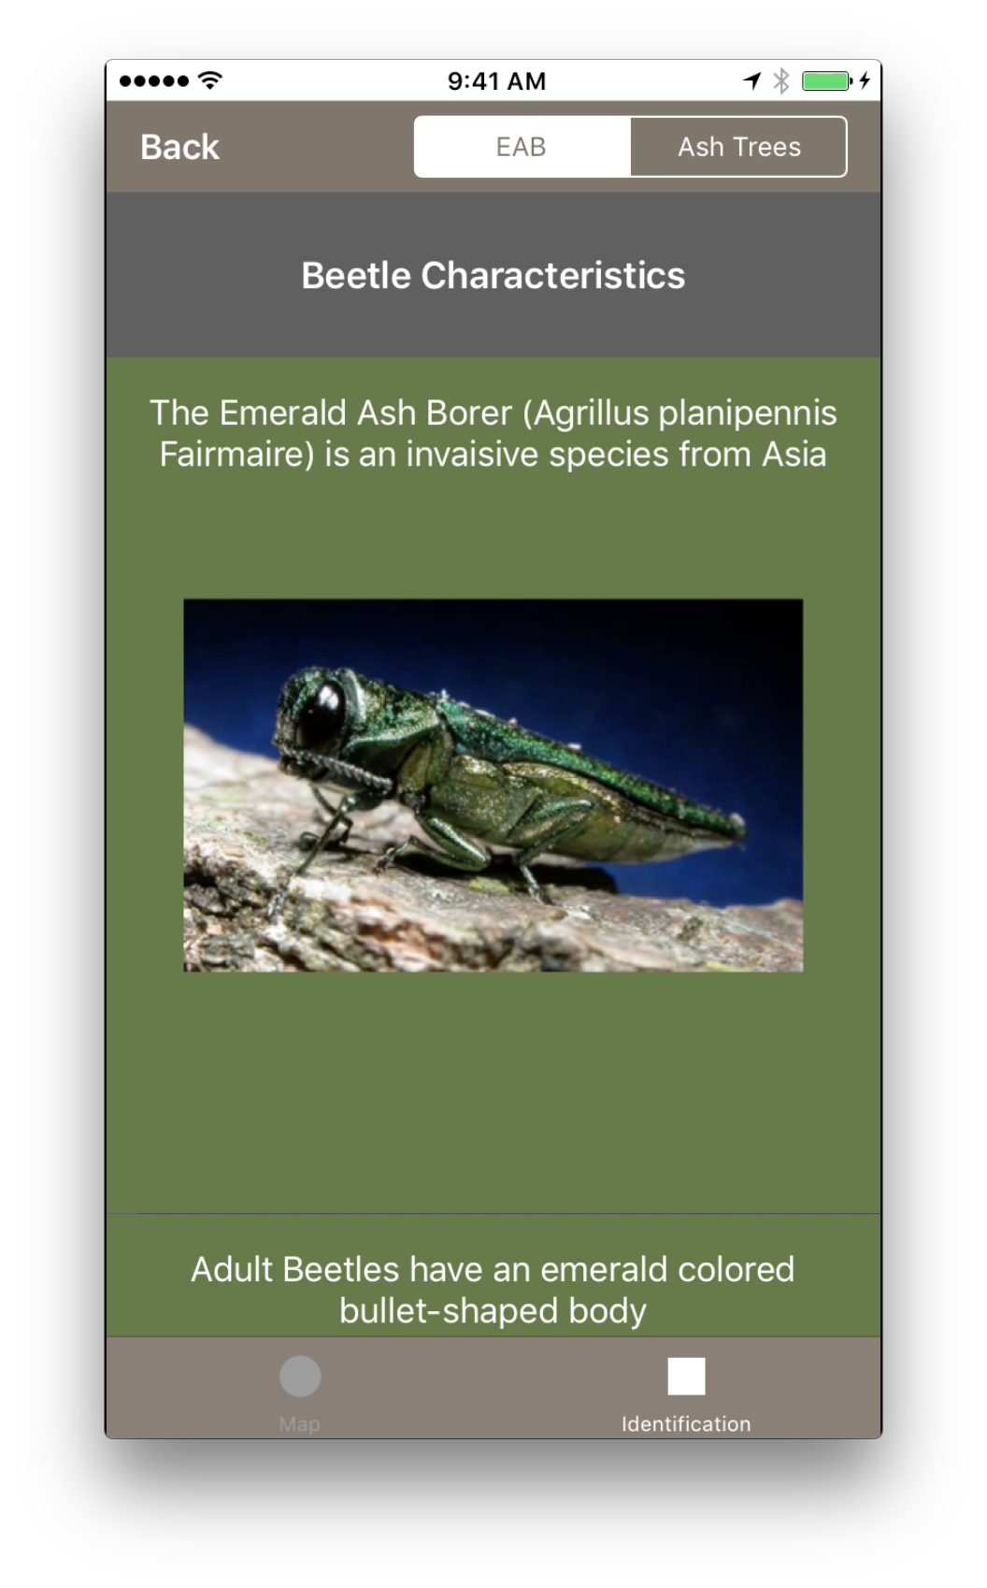
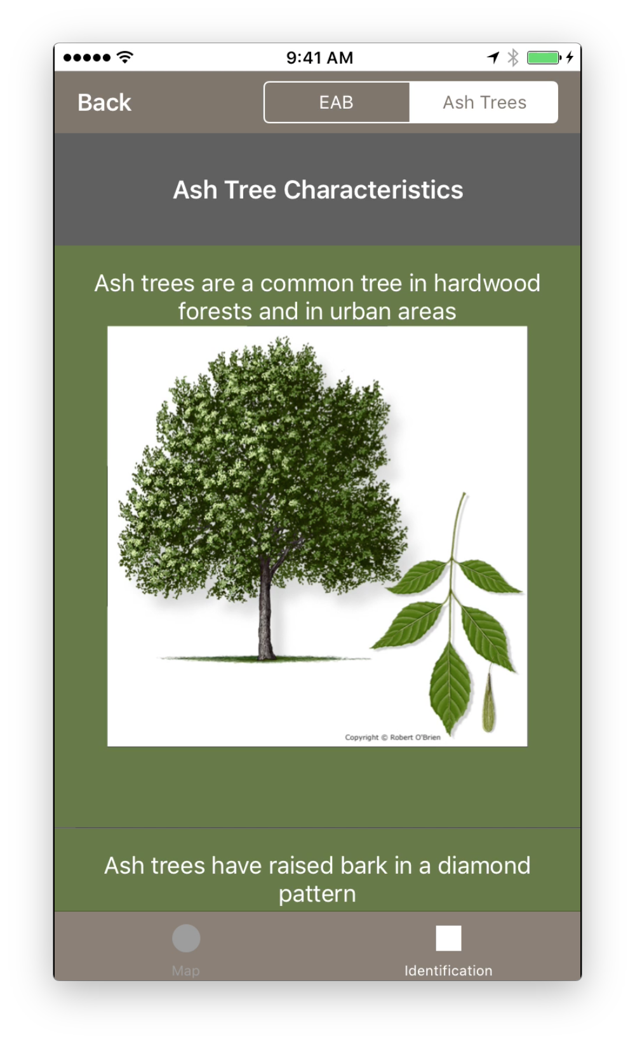

Slide 20
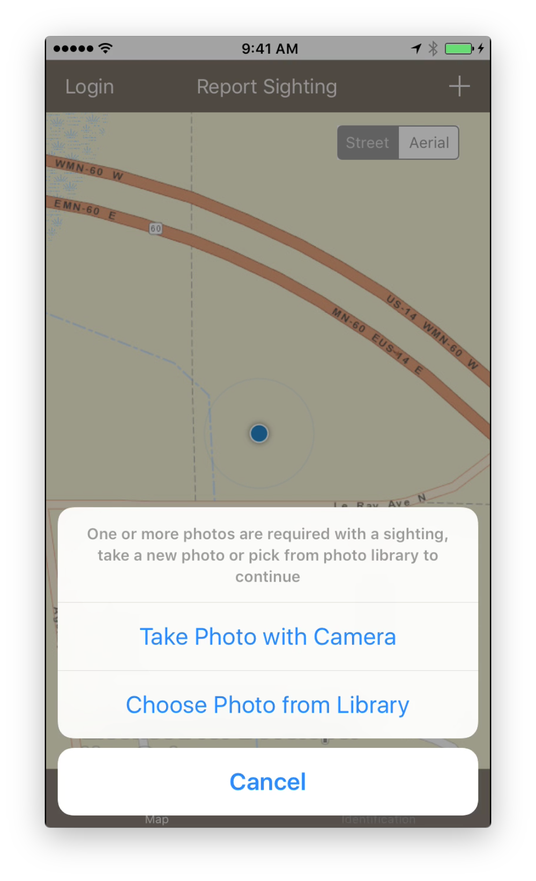
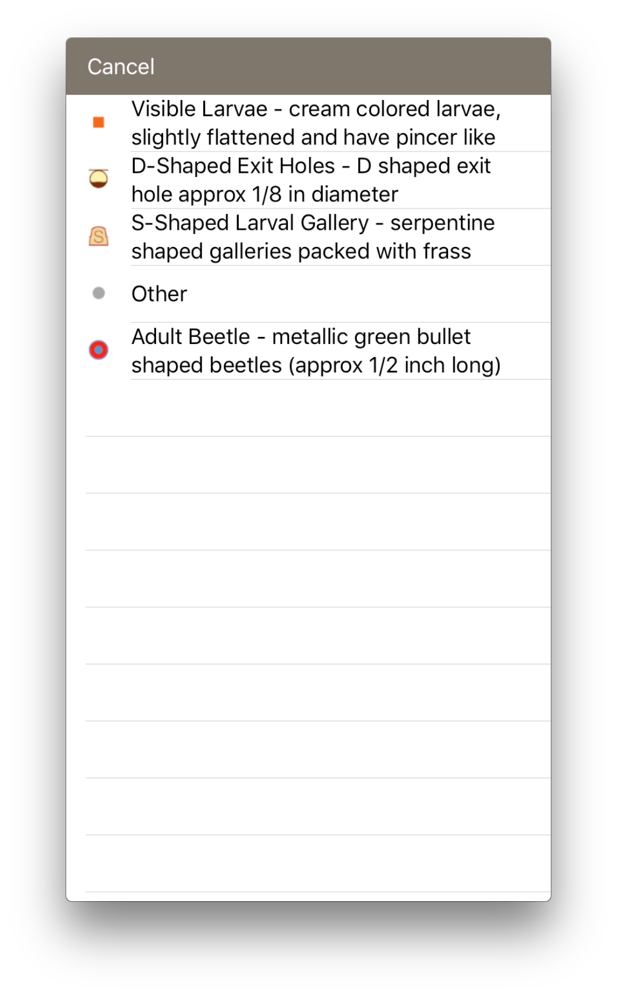
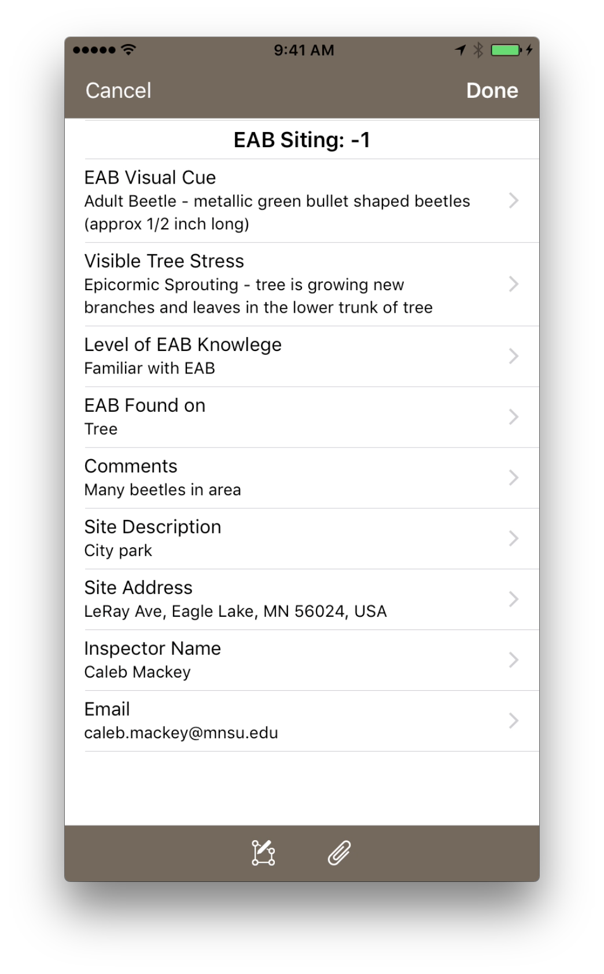

Slide 21
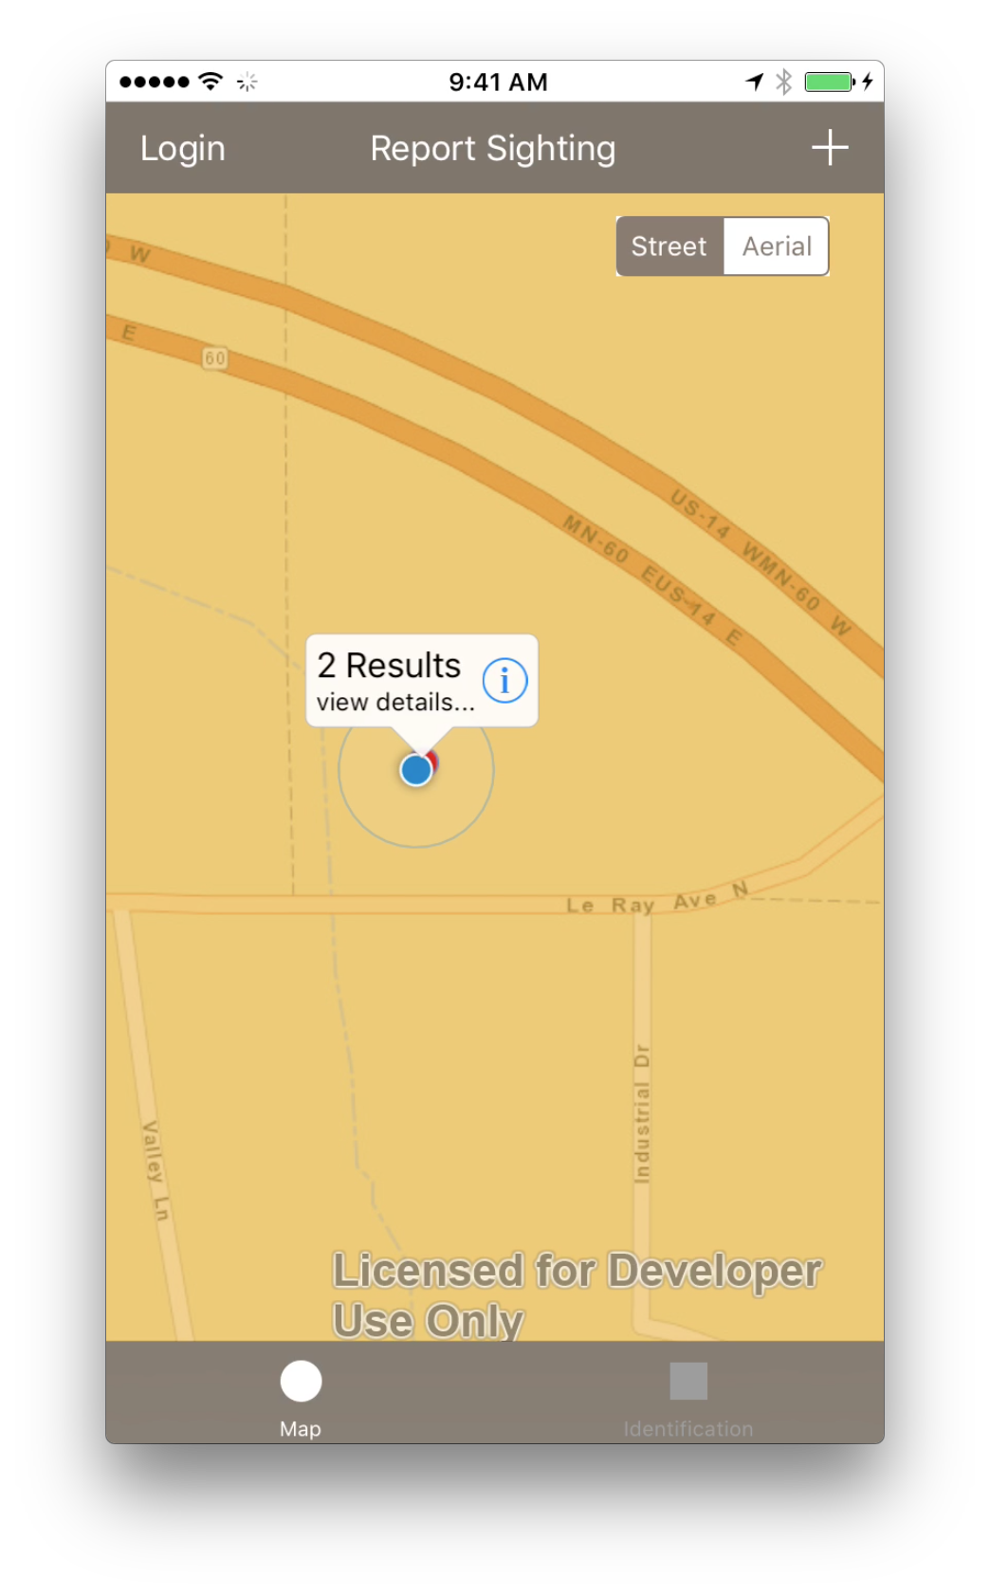
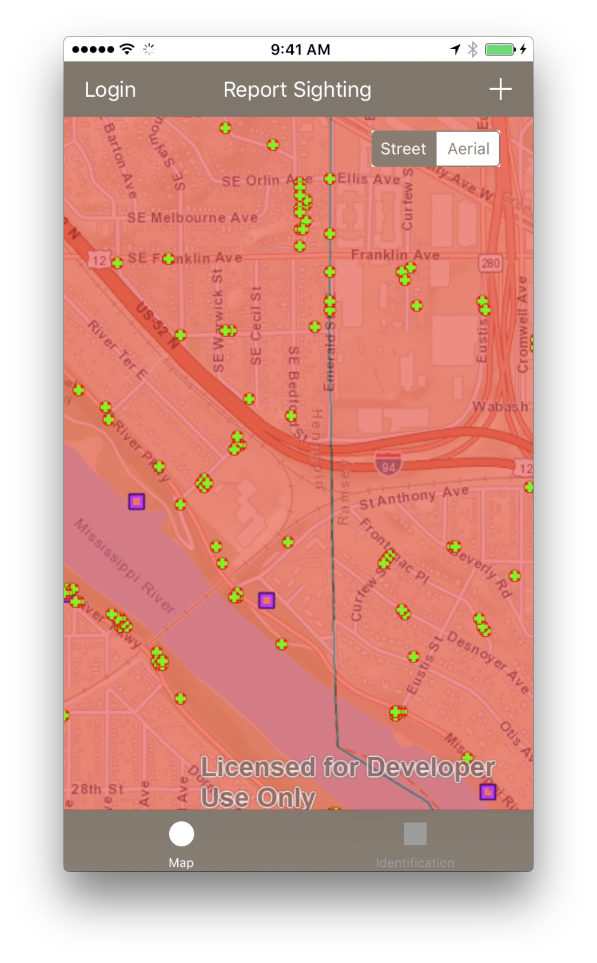
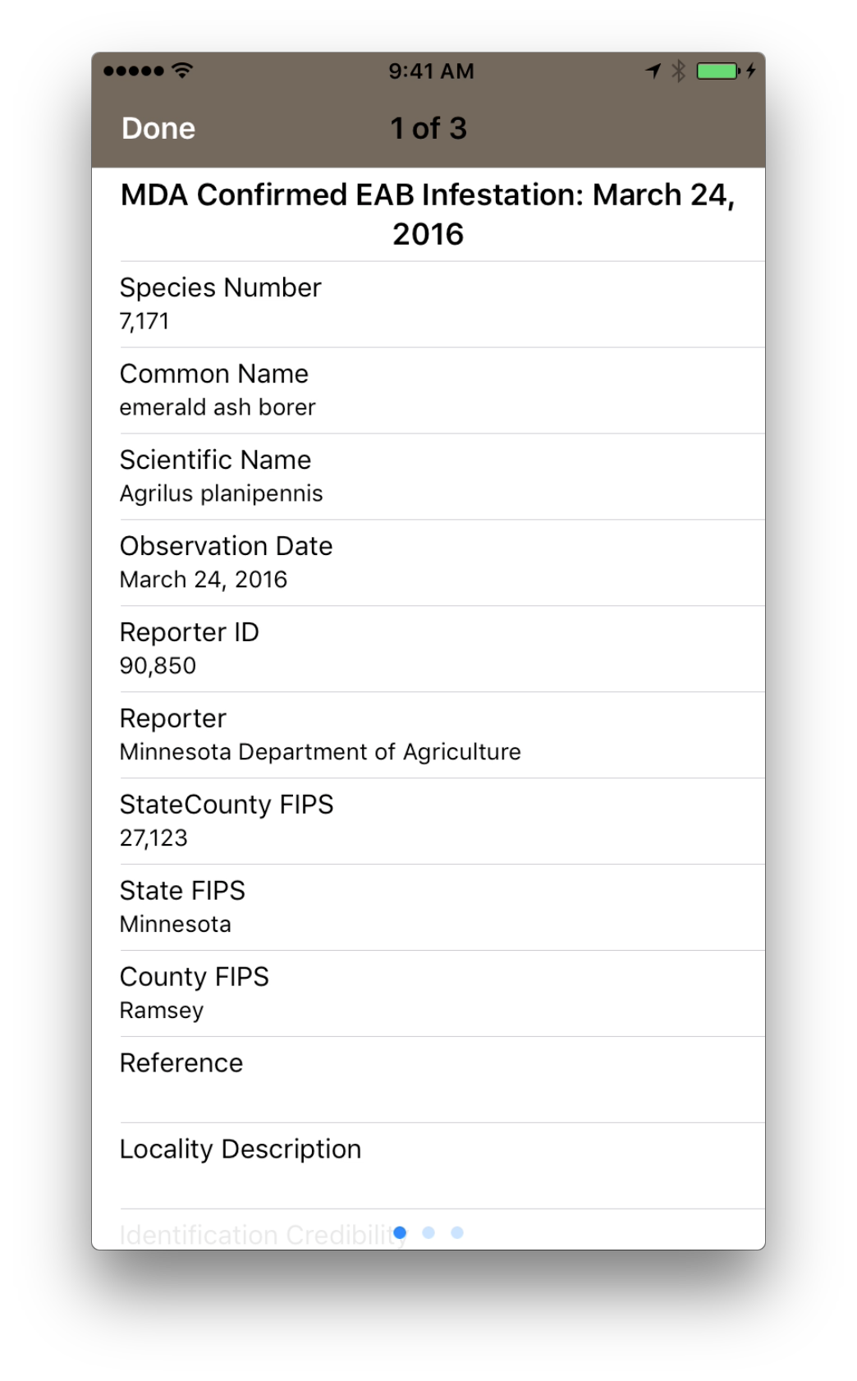

Slide 22
